Slide 1
Building Generative AI apps with your data in Azure Cosmos DB
James Codella, PhD
Principal Product Manager
Azure Cosmos DB

Slide 2
Azure Cosmos DB
Agenda
Customer use cases
AI features
Demo

Slide 3

Azure Cosmos DB for NoSQL
The world’s most scalable AI database
Serverless or Provisioned Throughput
Automatic sharding/partitioning
High elasticity with instant autoscale
Low latency, real-time data transactions
Mission critical reliability (99.999%)
5 levels of multitenancy
Built-in vector index and search with DiskANN

Slide 4





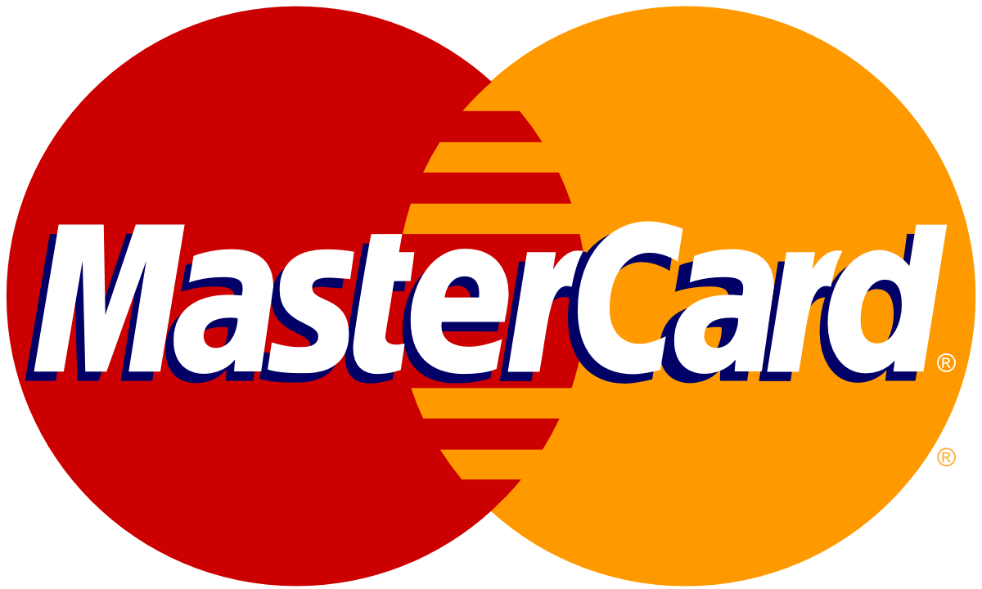
Common AI scenarios with Azure Cosmos DB for NoSQL
Chat History
RAG
Multitenant Apps
Real-time Recommendations
Anomaly Detection
Multi-agent AI

Slide 5
GenAI use cases for Azure Cosmos DB
What
Why
When
Drastically reduces latency
Saves on Token consumption
Reduces costs and latency for LLM
Semantic Caching
Slow moving / static content
FAQs, Policies…
Conversational context
UX & LLM optimizations
Auditing
Chat History
A MUST for Chat sessions
Improving cost & performance
Retrieval Augmented Generation (RAG)
Personalize LLM on your data
Cheaper than fine tuning
Faster iteration on new data
Any workload for GenAI apps
Vector + Operational Database
No ETL
Consistent data
Reduce complexity & costs
Data & vectors together
Cosmos DB scale & performance
Notes:
With these capabilities, the possibilities for Gen-AI scenarios using Azure Cosmos DB expand greatly.
Combining an Operational + Vector database, eliminates the need to ETL data into a single purpose vector database, reducing complexity and cost.
Building RAG Pattern applications gets easier and enables Gen-AI applications in mission critical and real-time workloads.
Cosmos DB has always been a favorite for building Chat applications. Users can now take chat history to improve user experience and optimize their LLMs.
And finally, it enables new innovations such as semantic caching, which drastically reduces costs and improves performance even more.
However, we’re not done yet. Azure Cosmos DB is known for its performance and scale, and we’re are going to take things even further.

Slide 6
Azure Cosmos DB for NoSQL AI features
Native Vector Indexing & Search
DiskANN
Vector Index
AI Framework Integrations
Public Preview
Gated Preview
Semantic Kernel
LangChain

Slide 7
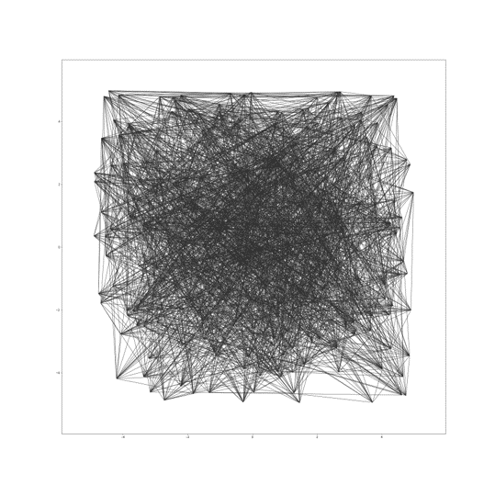

Azure Cosmos DB for NoSQL with DiskANN
Scalable and cost effective, ideal for multi-tenant apps
Vector compression
Storage and graph construction
Algorithms
Large Vectors
{ D1, D2, D3, D4, D5, …, D99, D100 }
RAM
Compressed vectors
Quantization
SSD
Compressed Vectors
{ D1, D2 .., D10 }
Full vectors + graph
Unlimited scale
Low latency
Robust to data changes
Serverless
^{*In preview, GA November ‘24}
Notes:
OWNER: KIRILL
Contrast with Mongo, AWS, GCP (Scann) Talking points:
Powers Bing and M365 copilots
Unlimited scale: indexes with up to 400B vectors, trillions data points
Low latency, single-digit ms
Robust to data changes, highest recall per TPS, e.g. >90% recall at million TPS
Serverless and multi-tenant friendly, demands >60x less memory than HNSW
Vector and Hybrid search (w/Full Text search and re-ranking) on operational data on top of same inverted index
LangChain and Ecosystem Integration

Slide 8
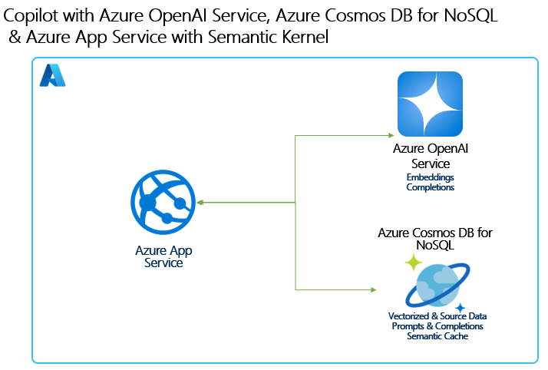
Let’s build an assistant powered by your data in Azure Cosmos DB!
Build a highly scalable, multi-tenant GenAI chat app using Azure Cosmos DB for NoSQL.
Implement a RAG pattern using vector search in Azure Cosmos DB for NoSQL on your data
Use Azure Cosmos DB to:
Mange chat history
Store and retrieve data for RAG with vector search
Semantic Caching

Slide 9
Demo
Build your own Copilot with
Azure Cosmos DB for NoSQL

Slide 10



Resources
https://aka.ms/CosmosVectorSearch
Azure Cosmos DB for NoSQL vector search overview
https://aka.ms/DiskANNSignUp
DiskANN gated preview sign-up page
https://aka.ms/CosmosDBDiskANNBlog
Announcement blog post
https://aka.ms/CosmosAISamples
Azure Cosmos DB AI samples (.NET + Python)
https://aka.ms/CosmosDB-nosql-copilot
Today’s demo

Slide 11

.NET Conf: Focus on AI
Learn more
aka.ms/dotnetFocusAI/Collection

